Slide 1
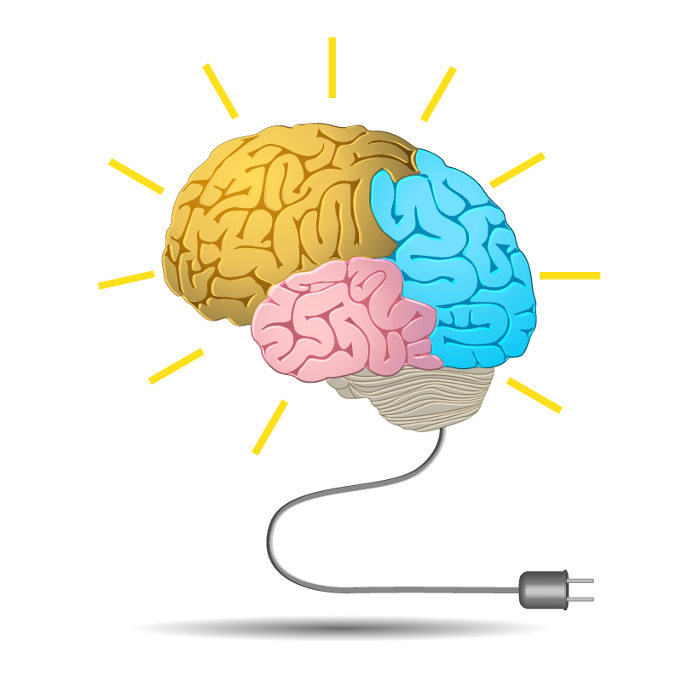


MEMORY
Miss Aisha Bano
aisha.bano@nu.edu.pk

Slide 2
Table of Contents
Memory (Definition)
Process
(Encoding with the role of attention, Storage, Retrieval)
Types of Memory
Sensory (Echoic & Iconic)
Short-term
Long-term memory
Declarative or Explicit (Semantic & Episodic)
Non-declarative or Implicit (Procedural, Condition disposition)
Models in memory
Atkinson & Shiffrin
Memory Span by Hermann Ebbinghaus
Methods (Recall, Recognition, Relearning)
The neuroscience of memory Role of amygdala and hippocampus

Slide 3
Table of Contents (cont…)
How to improve memory
ways to improve memory
Mnemonics
Forgetting (Definition)
Theories of forgetting
Decay Theory
Interference Theory -- Proactive and Retroactive Interference
Motivated forgetting (Repression)
Cue dependent forgetting or Retrieval failure theory
Impairments Amnesia (definition)
Types (Anterograde Amnesia, Retrograde Amnesia)
Diseases (Alzheimer, Korsakoff)

Slide 4

Memory
The ability to retain knowledge
(Cacioppo & Freberg, 2013)
The process by which we encode, store, and retrieve information. (Feldman, 2011)
Information Processing
A continuum including attention, sensation, perception, learning, memory and cognition.

Slide 5



Memory Processes
3 R ’s of Memory
01
Recording
(encoding)
Retrieval
(recall)
Retention
(storage)
03
02

Slide 6

Recording
(ENCODING)
The process of transforming information into a form that can be entered and retained in the memory system.
The process of transforming the information from one form to another is called recording.
(Feldman, 2011)
start now
information

Slide 7

Retention
(STORAGE)
The process of retaining information in memory so that it can be used later.
The process of storing the information is called retention.
(Feldman, 2011)
start now
information

Slide 8
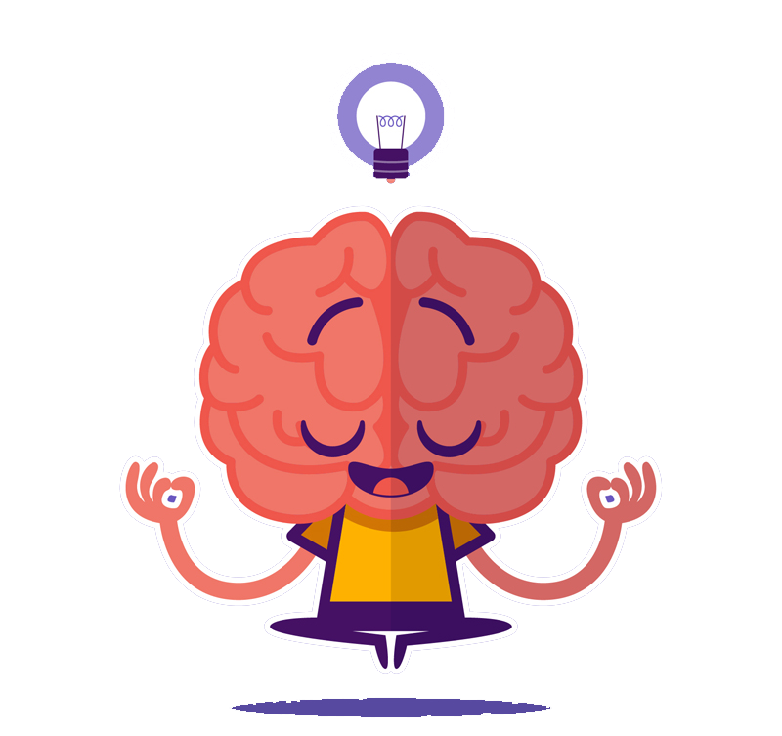
Retrieval
(RECALL)
The process of recovering information stored in memory so that we are consciously aware of it.
The recovery of stored information is called retrieval. (Feldman, 2011)
start now
information

Slide 9
Cognitive Map theory by Edward Tolman (1948)
This theory is about memory systems (code, store, recall and decode)
A Cognitive Map is any visual representation of a person’s (or a group’s) mental model for a given process or concept.
The influential cognitive map theory proposes that memories of recently travelled routes are combined with memories of previously travelled routes to create an integrated map of the environment.

Slide 10
THREE STAGES OF MEMORY
Three memory stores that differ in function, capacity and duration are :
01
02
03
Sensory
memory
Short-term
memory
Long-term
memory
(also called working memory)

Slide 11
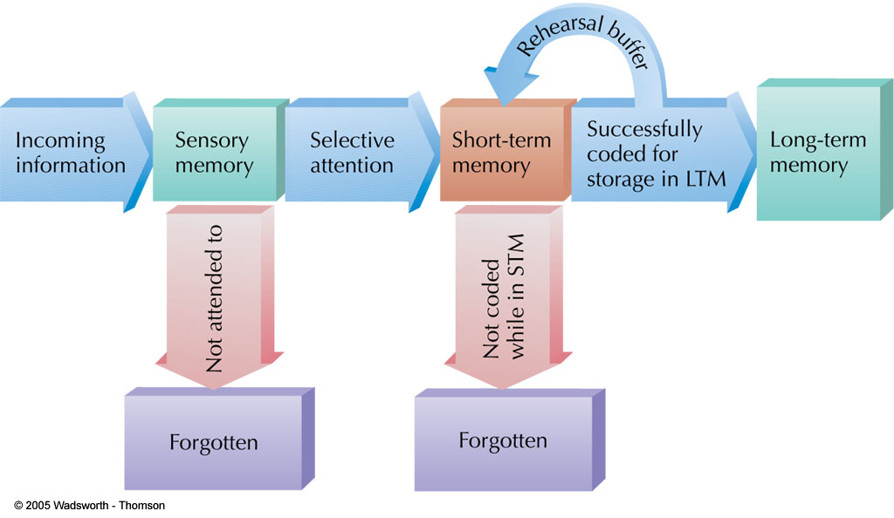
STAGES OF MEMORY

Slide 12


1. Sensory Memory
The first stage of A-S (Atkinson-Shiffrin) model that holds large amounts of incoming data for very brief amounts of time. (Cacioppo & Freberg, 2013)
The initial, momentary storage of information, lasting only an instant.
(Feldman, 2011)

Slide 13
Sensory Memory
Function : process for basic physical characteristics
Capacity : large
can hold many items at once
Duration : very brief retention of images
3 sec for visual info
2 sec for auditory info
Divided into two types:
iconic memory–visual information
echoic memory– auditory information
Attention is needed to transfer information to working memory
Attention involves focusing awareness on a narrowed range of stimuli or events (Weiten, 2011 )
Sensory
Memory
Sensory
Input

Slide 14


Sensory Memory
Visual sensory memory brief memory of an image or icon. Also called iconic memory.
Auditory sensory memory brief memory of a sound or echo. Also called echoic memory.

Slide 15

2. Short-Term Memory
(STM) /( Working Memory)
The second stage of A-S model that holds a small amount of information for a limited time. (Cacioppo & Freberg, 2013)
Memory that holds information for 15-25 seconds called STM. (Feldman, 2011)

Slide 16
3. Short-Term Memory
(STM) /( Working Memory)
Function : conscious processing of information
where information is actively worked on
Capacity : limited (holds 7+/-2 items)
Duration : brief storage (about 25 Sec)
Sensory
Memory
Working or
Short-term
Memory
Sensory
Input
Attention

Slide 17
Maintenance Rehearsal of STM
Maintenance
Rehearsal
Sensory
Memory
Working
or
Short-term
Sensory
Input
Attention

Slide 18

CHUNKING
A meaningful grouping of stimuli that can be stored as a unit in Short Term Memory. (Feldman, 2011)
The process of grouping similar or meaningful information together.
(Cacioppo & Freberg, 2013)
Chunks expand working memory load

Slide 19
ACTIVITY
Which is easier to remember?
4 8 3 7 9 2 5 1 6
483 792 516
t h e o c e a n i s b l u e a n d b e a u t i f u l
The ocean is blue and beautiful

Slide 20

Long-Term Memory (LTM)
The final stage of the A-S Model that is the location of permanent memory.
(Cacioppo & Freberg, 2013)
Memory that stores information on a relatively permanent basis, although it may be difficult to retrieve. (Feldman, 2011)
start now
information

Slide 21
Long-Term Memory (LTM)
Once information passes from sensory to working memory, it can be encoded into long-term memory.
Function: Organizes and stores information
more passive form of storage than working memory
Capacity: Unlimited
Duration: Relatively permanent
Example: flashbulb memory
Unusually vivid and detailed recollections of momentous events.
start now
information

Slide 22

re
The Atkinson and Shiffrin Model of Memory Storage
Maintenance Rehearsal
Sensory
Memory
Working
or
Short-term
Long Term
Memory
Attention
Encoding
Sensory
Input
Retrieval

Slide 23
Long-Term Memory (LTM)
Encoding—process that controls movement from working to long-term memory store.
It involves forming a memory code.
Retrieval—process that controls flow of information from long-term to working memory store

Slide 24

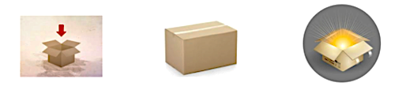
Long-Term Memory (LTM)
Encoding
Storage
Retrieval

Slide 25
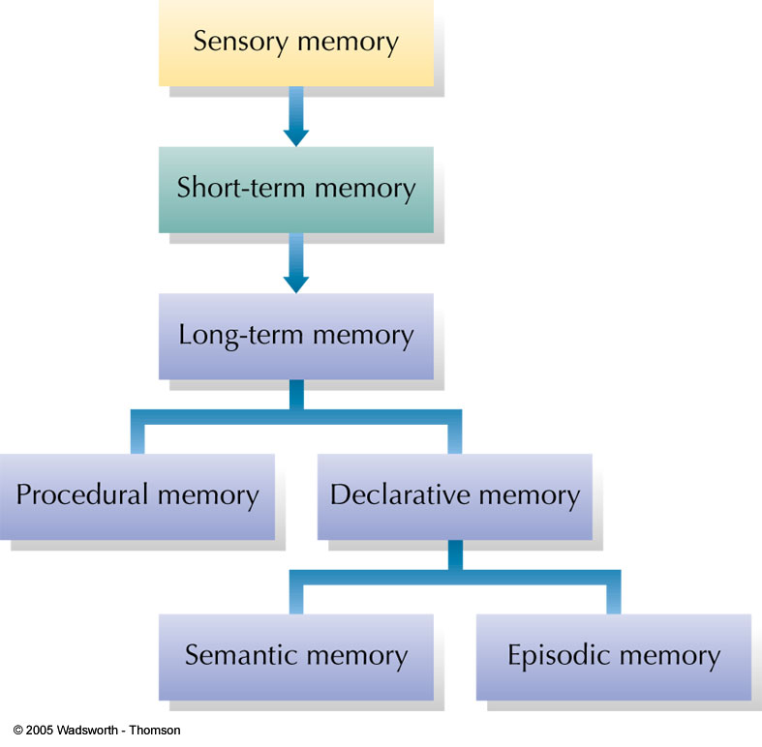
Classification Model of Memory
In the model shown here, long-term memory is divided into procedural memory (learned actions and skills) and declarative memory (stored facts).
Declarative memories can be either semantic (impersonal knowledge) or episodic (personal experiences associated with specific times and places).

Slide 26
Types of Long-term Memory
Declarative memory
Memory with awareness, effortful processes
Information can be consciously recollected
Also known as Explicit memory
Non-Declarative memory/Procedural memory
Memory without awareness (largely automatic), with little effort and attention
Memory that affects behavior but cannot consciously be recalled
Also known as Implicit memory

Slide 27
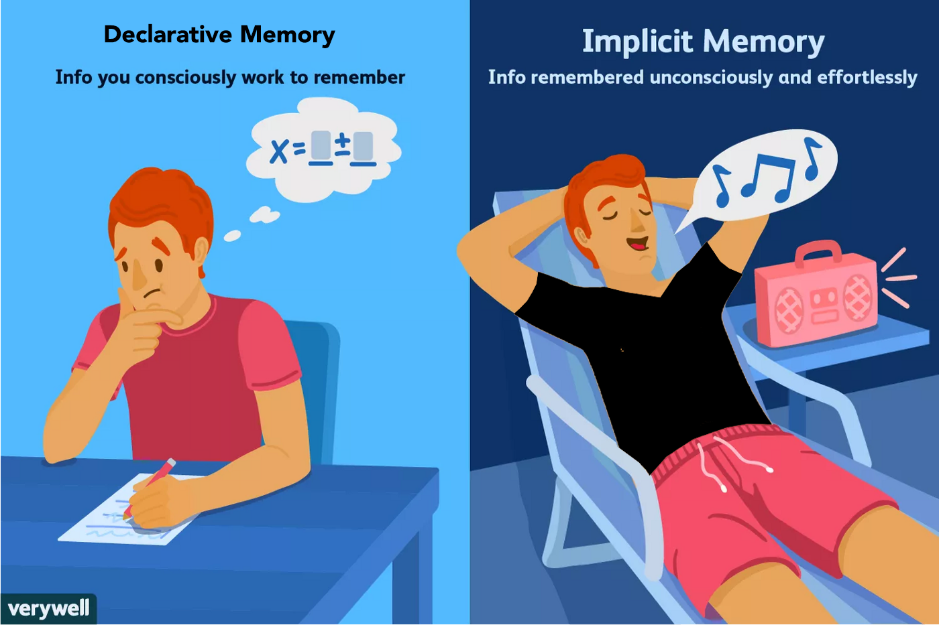
Non-Declarative memory

Slide 28
1: Declarative Memory (Explicit memory)
Based on Factual information.
Memory consciously recalled or declared.
Can use explicit memory to directly respond to a question
Two subtypes of declarative memory. Both types contain factual information
Semantic memory (general knowledge)
Episodic memory (dated recollections of personal experiences)

Slide 29
Type of Declarative Memory
i. Semantic Memory
(General memory)
Information about impersonal facts and general knowledge
e.g., North is cold and beautiful
Memory not tied to the time when the information was learned
General facts and definitions about the world
Examples:
Usually, a car has four wheels.
Color of strawberry is red and it’s useful for health
Does NOT depend on tying the item to your past

Slide 30
Type of Declarative Memory
ii. Episodic Memory
(Personal knowledge)
Information about events or “episodes”
Memory tied to specific time, your own personal experiences, such as things you’ve done, seen, and heard
.
General facts and definitions about the world in chronological, or temporally dated, recollections of personal experiences.
Examples:
Your birth month
Your best memory till date
Date of birthday or wedding ceremony
Remembering your visit to any picnic place

Slide 31
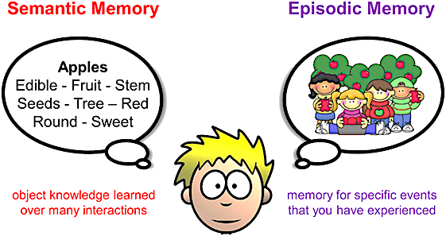
Types of Declarative Memory

Slide 32




2: Non-Declarative Memory
(Procedural Memory)
Memory that enables a person to perform specific learned skills or habitual responses, includes actions, perceptual motor skills, conditioned reflexes, emotional memories.
Don’t have to consciously remember the steps involved in the actions to perform them.
Examples
02
04
01
03
Riding a
bike
Knowing
how to swim.
Using the shift stick while driving.
Tying your
shoelaces.

Slide 33
Cognitive domain of LTM
Retrospective memory is memory of people, words, and events encountered or experienced in past
i.e., the recollection of past episodes.
Prospective memory is where the content is to be remembered in the future and may be defined as “remembering to remember” or remembering to perform an intended action.
It includes semantic , episodic
and autobiographical memory, and declarative memory in general, although it can be either explicit or implicit.
It may be either event-based or time-based, often triggered by a cue, such as going to the doctor (action) at 4 pm (cue), or remembering to post a letter (action) after seeing a mailbox (cue)

Slide 34
How memories are organized?
Clustering--organizing items into related groups during recall from long-term memory.
Mental links between concepts
common properties provide basis for mental link
Shorter path between two concepts == stronger association in memory

Slide 35
The Neuroscience of Memory
Hippocampus: Brain structure associated with information passing from short-term memory into long-term memory.
If damaged, person can no longer “create” long-term memories
Memories prior to damage will remain intact.
Amygdala: A pair of small almond-shaped region in the brain, help regulate emotion and encode memories—especially when it comes to more emotional remembrances
- It triggers a person’s fight-or-flight response (activation of sympathetic division).

Slide 36
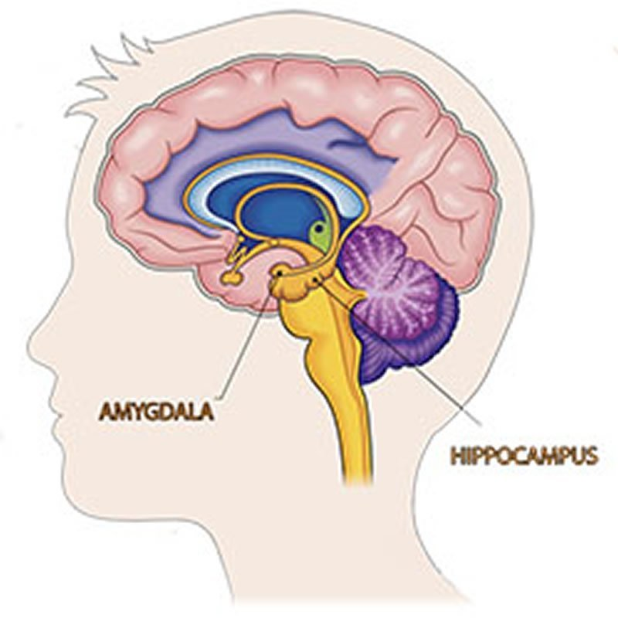

Slide 37




Ways to Improve Memory
1. Knowledge of Results
Feedback allowing you to check your progress
2. Recitation
Summarizing aloud while you are rehearsing material
3. Rehearsal
Reviewing information mentally (silently)
4. Elaborative Rehearsal
Looks for connections to existing knowledge
5. Selection
Selecting most important concepts to memorize
6. Organization
Organizing difficult items into chunks; a type of reordering

Slide 38



Ways to Improve Memory
7. Whole Learning
Studying an entire package of information at once, like a poem
8. Part Learning
Studying subparts of a larger body of information (like text chapters)
9. Progressive Part Learning
Breaking learning task into a series of short sections

Slide 39





Ways to Improve Memory
10. Spaced Practice
Alternating study sessions with brief rest periods
11. Massed Practice
Studying for long periods without rest periods
12. Sleep
Lack of sleep decreases retention whereas sleep aids consolidation
13. Hunger
Hunger decreases retention so requires gratification
14. Cognitive Interview
Technique used to improve memories of eyewitnesses

Slide 40
Mnemonics
Any kind of memory system or aid
Use mental pictures
Make things meaningful
Make information familiar
Form bizarre, unusual or exaggerated mental associations
Keyword Method: Memory aid; using a familiar word or image to link two items.

Slide 41
Using Mnemonics to Remember Things in Order
Form a Chain: Remember lists in order, forming an exaggerated association connecting item one to two, and so on.
Take a Mental Walk: Mental walk along a familiar path, placing objects or ideas along the path (it’s also called method of loci).
"loci" is the plural of locus, which means location, or place

Slide 42
Forgetting
Definition forgetting:
It refers to the failure to remember material previously learned (American Psychological Association, 2018).
Hermann Ebbinghaus’s contribution in 1885
The first person to conduct scientific studies of Forgetting
He invented Nonsense Syllables (consonant-vowel-consonant arrangements that do not correspond to words such as BAF, XOF, VIR, and MEQ)
(Weiten book, page 238)

Slide 43
Why do we forget ? Slide not included in exam
Sensory memory
The senses momentarily register amazing detail
Short-term memory
A few items are both noticed
and encoded
Forgetting can occur at any memory stage.
Long-term storage
Some items are altered or lost
Retrieval from long-term memory
Depending on interference, retrieval
cues, moods, and motives, some
things get retrieved, some don’t

Slide 44
Measures of Forgetting
Psychologists use three methods to measure forgetting/ retention
The retention refers to the proportion of material retained (remembered) or the amount forgotten.
1. Recall
A recall measure requires participants to reproduce information on its own without any cues.
2. Recognition
A recognition measure of retention requires participants to select previously learned information from an array of options.
3. Relearning
A relearning measure of retention requires a participant to memorize information a second time to determine how much time or effort is saved by having learned it before.

Slide 45
Impairments Amnesia
Amnesia : severe memory loss
Retrograde amnesia : Inability to remember past episodic information; common after head injury; need for consolidation
Anterograde amnesia : Inability to form new memories; related to hippocampus damage
Korsakoff: a disease that afflicts long-term alcoholics Add detail from lecture & book
Alzheimer: daily life forgetting (esp new memories formation is weak) Add detail from lecture & book

Slide 46
Theories of Forgetting
Encoding Failure: Pseudoforgetting is usually attributed to lack of attention. When a memory was never formed in the first place
Memory Traces: Physical changes in nerve cells or brain activity that occur when memories are stored
Memory Decay: This theory proposes that forgetting occurs because memory traces fade with time. When memory traces become weaker; fading or weakening of memories; happens frequently for sensory memories and short-term memories.
Disuse: Theory that long-term memory traces weaken when memories are not used or retrieved often

Slide 47
Theories of Forgetting
Interference theory
This theory proposes that people forget information because of competition from other material.
Two kinds of Interference:
Retroactive interference
When new information (List B) impairs the retention of previously learned information (List A). (material learned later disrupts the retrieval of information that was learned earlier)
2. Proactive interference
When previously learned information (List A) interferes with the retention of new information. (information learned earlier disrupts the recall of newer material)
Motivated forgetting or Repression
It refers to keeping distressing thoughts and feelings buried in the unconscious.
Sigmund Freud asserted that people often keep embarrassing, unpleasant, or painful memories buried I their unconscious.

Slide 48
Theories of Forgetting
Cue dependent forgetting
The encoding specificity principle states that the value of a retrieval cue depends on how well it corresponds to the memory code. (detail on page 240, Weiten)
Tip of the tongue phenomenon– the temporary inability to remember something you know, accompanied by a feeling that it’s just out of reach.

